Slide 1
CUSTOMER CHURN PREDICTION

Slide 2
Table of contents
01
02
03
04
05
06
BACKGROUND
DATA DESCRIPTION
DATA EXPLORATION
DATA PREPARATION
DATA MODELING
FINDINGS

Slide 3
BACKGROUND
The telecom company is facing a significant challenge related to customer churn, a critical metric that reflects the rate at which customers discontinue their services or switch to competitors. The objective is to understand and address the factors contributing to high customer churn.

Slide 4
DATA DESCRIPTION
The Telco Customer Churn data provides insights into the dynamics of a fictional telco company operating in California. The dataset encompasses 7043 customers, detailing their engagement status—whether they have left, stayed, or recently signed up for services.
This comprehensive dataset serves as a valuable resource for analyzing customer behavior and identifying factors influencing churn.

Slide 5
DATA DESCRIPTION
The dataset comprises 7,043 fictitious customers, each belonging to different demographics such as single, with dependents, or senior citizen.
These customers have subscribed to various product offerings provided by a telecom company in California.
All feature: 20 (Independent 19 + Target 1)
Independent features : 19 (Categorical 16 + Numerical 3)
Target feature: “Churn”
Dataset source: https://community.ibm.com/community/user/businessanalytics/blogs/steven-macko/2019/07/11/telco-customer-churn-1113

Slide 6
DATA DESCRIPTION
17 Categorical features
3 Numerical features
4 - Nominal features
13 - Ordinal features
2 - Continuous features
1 - Discrete feature

Slide 7
DATA EXPLORATION
Around 26.5% of customers have left the platform in the last month.
26%
70%
Approximately 70% have an internet service provider.
90%
90% of customers receive telephone service.

Slide 8
DATA PREPARATION
'gender', 'PaymentMethod', 'Contract', 'InternetService' columns need one hot encording.
Other categorical columns need label encording.
The variables "Streaming TV" and "Streaming Movies" exhibit similarity and have been combined into a consolidated variable named "StreamingService" to streamline the data without significant information loss.
The variables "OnlineSecurity", "OnlineBackup", "DeviceProtection", "TechSupport", exhibit similarity and have been combined into a consolidated variable named "OnlineService" to streamline the data without significant information loss.

Slide 9
DATA PREPARATION
“Total Charges” has 11 missing values.
Dataset where the information on the "TotalCharges" of customers who have stayed with the company for less than one month is missing. In such cases, we can use the data from their "MonthlyCharges" column to impute or estimate the missing values for "TotalCharges.
And increace every customer tenure by 1.

Slide 10
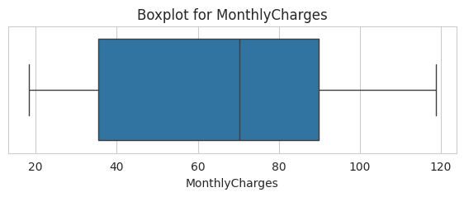
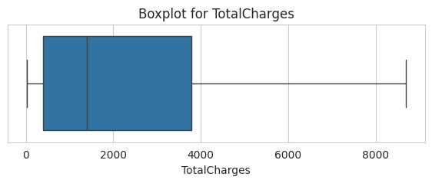
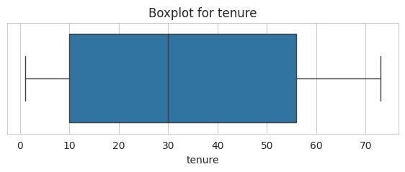
DATA PREPARATION
There are no outliers in the numerical columns, and thus, there is no need to treat or address them.
Since we intend to construct a machine learning model using tree-based algorithms, there is no requirement to transform the data into a normal distribution

Slide 11
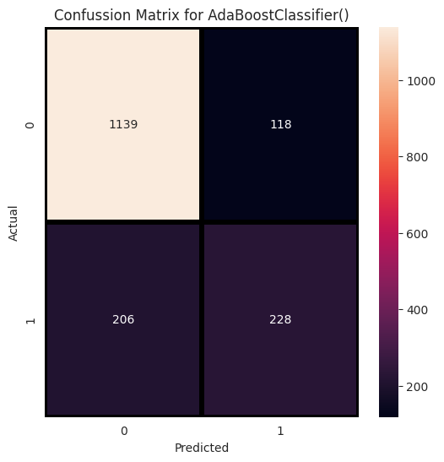
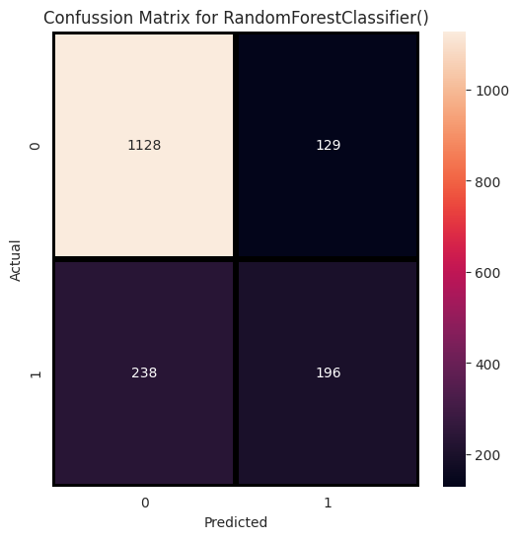
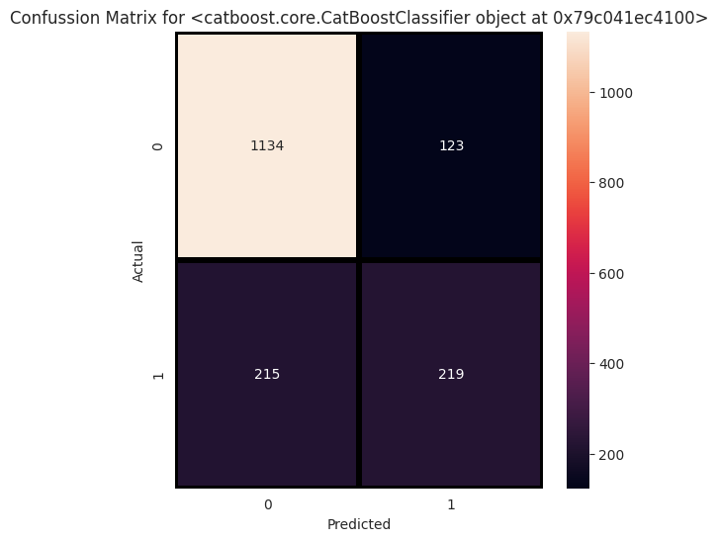
DATA MODELING
Before balancing classes, AdaBoostClassifier, RandomForestClassifier and CatBoost demonstrates low Type 1 and Type 2 errors, making it a favorable estimator.
Confussion matrix for
AdaBoostClassifier
Confussion matrix for
RandomForestClassifier
Confussion matrix for
CatBoostClassifier

Slide 12
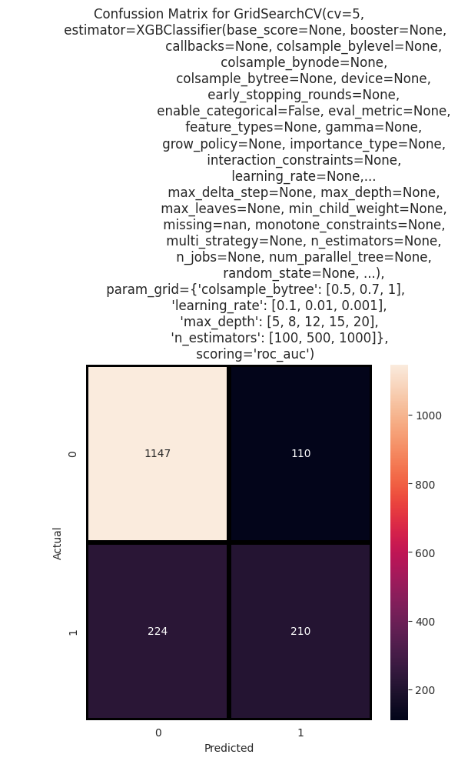
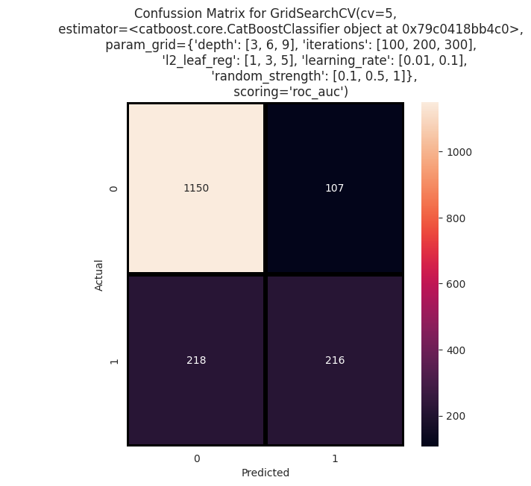
DATA MODELING
Among the classifiers tested, the CatBoostClassifier and XGBClassifier yielded the highest ROC AUC score, after Hyperparameter Optimization.
Confussion matrix for
CatBoostClassifier
Confussion matrix for
XGBClassifier

Slide 13
FINDINGS
The analysis reveals that customer churn is notably high under the following conditions:
Customers without dependents are observed to have a higher likelihood of churning.
Specifically, customers with phone services incurring high costs are more prone to churn.
Customers who solely subscribe to a single line service without opting for combo services exhibit a higher rate of churn.
The use of techniques such as SMOTE, ADASYN, and random oversampling is aimed at addressing imbalances in datasets. However, it's important to note that while these methods can help mitigate class imbalance, they may also have an impact on the overall performance of machine learning models, potentially leading to a reduction in their effectiveness.

Slide 14
CONCLUSION
CatBoostClassifier demonstrates the highest ROC AUC of 0.8441 before implementing class balancing. Before balancing classes, the XGBClassifier achieves an accuracy of approximately 0.8412.
Customer churn poses a significant threat to a firm's profitability. To effectively combat churn, it is crucial for a company to have a deep understanding of its customers. This involves pinpointing customers at risk of churning and actively working to enhance their satisfaction. A primary focus should be on elevating customer service to the forefront of strategic priorities. Additionally, fostering customer loyalty through personalized experiences and specialized services proves to be an effective strategy for reducing churn.
One proactive approach involves surveying customers who have already churned to gain insights into their reasons for leaving. This information can then be utilized to implement preventative measures and avoid future instances of customer churn.

Slide 15
Thank You!
Do you have any questions?
pinildissanayaka@gmail.com
+94 78 645 0938

